Slide 1
Transport Layer

Slide 2
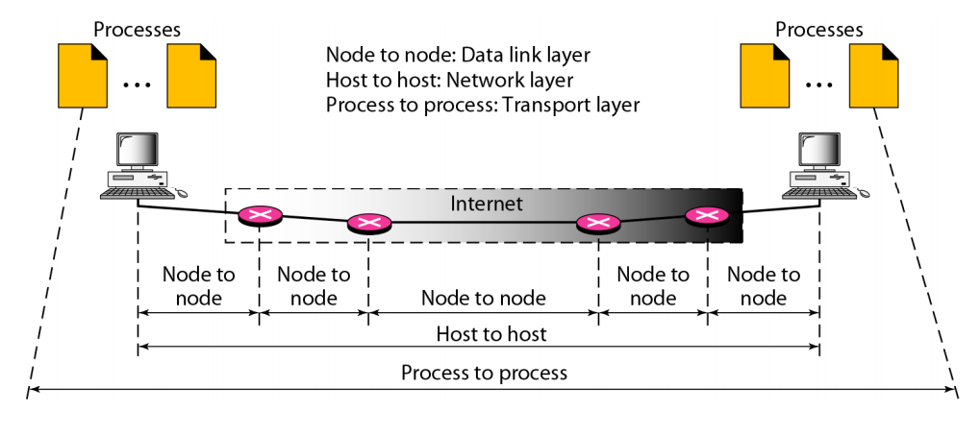
Process to process delivery
The transport layer is responsible for process-to process delivery-the delivery of a packet, part of a message, from one process to another.

Slide 3
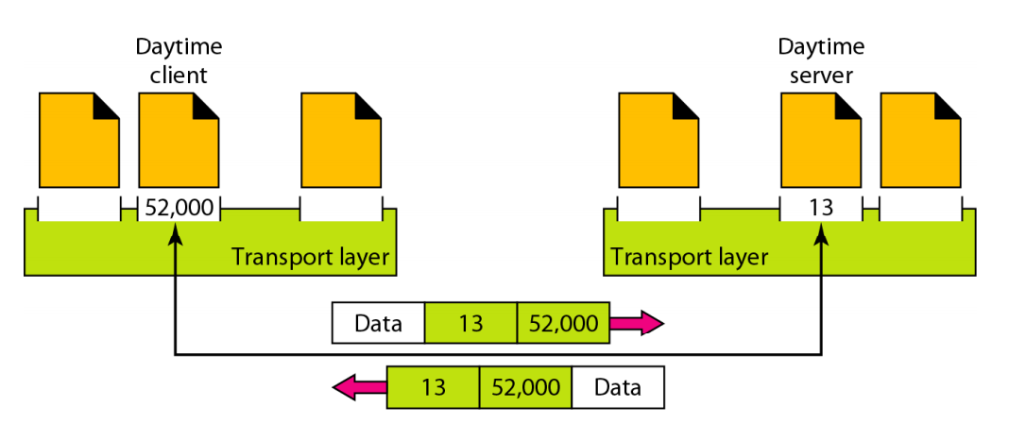
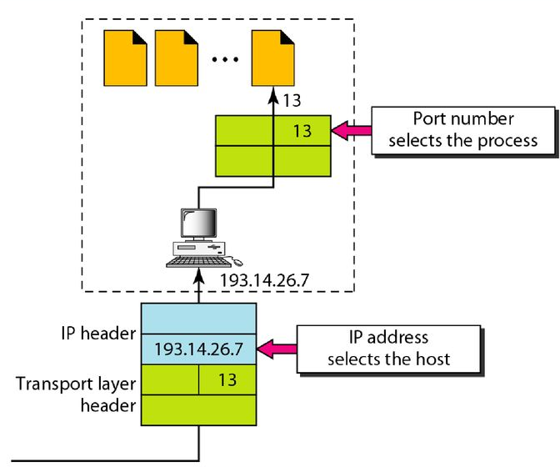
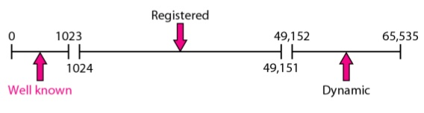
Port Numbers

Slide 4
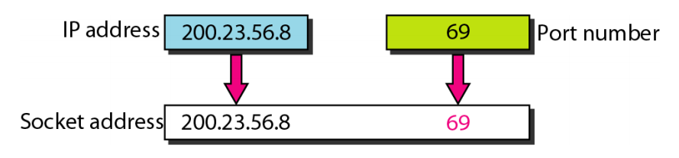
Socket Addresses

Slide 5
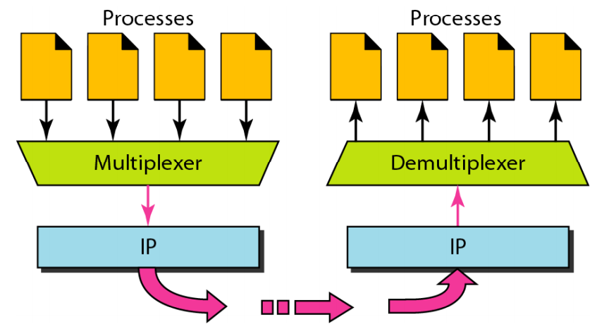
Multiplexing and Demultiplexing

Slide 6
Connectionless Vs. Connection-Oriented Service
Connectionless Service:
packets are sent from one party to another with no need for connection establishment or connection release.
packets are not numbered;
Packets may be delayed or lost or may arrive out of sequence.
There is no acknowledgment.
Absence of ACK ensures faster delivery
E.g. UDP, is a connectionless transport layer protocol.
Connection Oriented
a connection is first established between the sender and the receiver.
Connection does not mean physical path, it’s a virtual connection
Then data are transferred.
Packets may travel through different physical path
At the end, the connection is released.
Concept of ACK exists.
E.g. TCP and SCTP are connection-oriented protocols.

Slide 7
Reliable Vs. Unreliable
If the application layer program needs reliability,
a reliable transport layer protocol is used
It implementing flow and error control at the transport layer.
TCP and SCTP are connection oriented and reliable.
If the application program does not need reliability
maybe it uses its own flow and error control mechanism or
it needs fast service or
the nature of the service does not demand flow and error control (real-time applications)
Fast delivery is more important than correct delivery.
UDP is connectionless and unreliable;

Slide 8
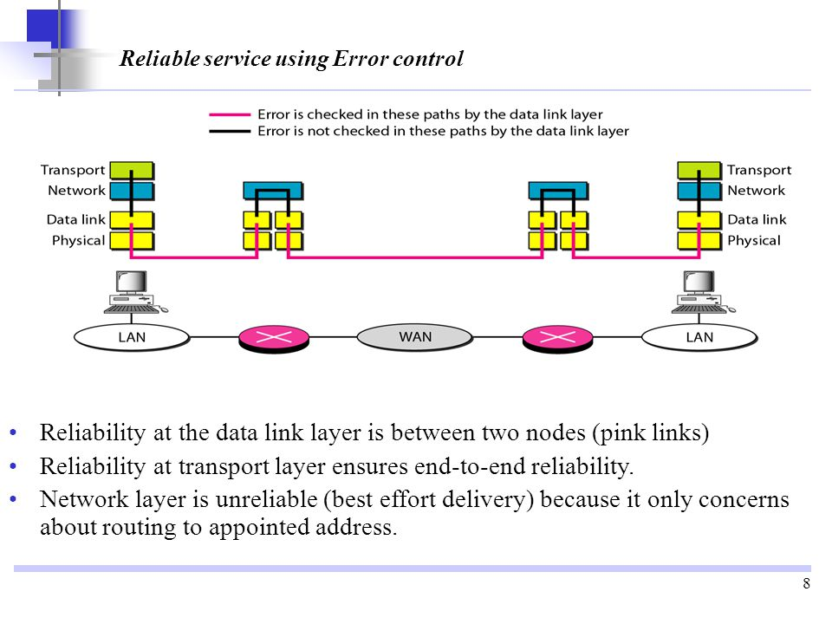
If the data link layer is reliable and has flow and error control, do we need this at the transport layer, too?
YES WE NEED.
Since, network layer in the Internet is unreliable (best-effort delivery)
we need to implement reliability at the transport layer

Slide 9
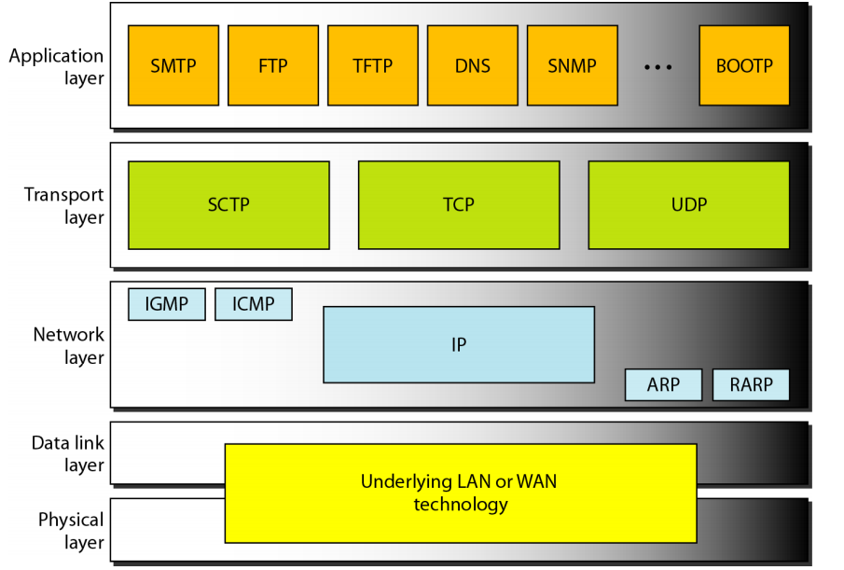
Position of UDP, TCP and SCTP in the transport layer of TCP/IP suite

Slide 10
User Datagram Protocol (UDP)
It is connectionless
No connection set up or release
It is unreliable
No acknowledgement involved
It does not add anything to the IP services except to provide process-to process communication instead of host-to-host communication.
It also performs very limited error checking.
Why would a process want to use it?

Slide 11
Advantages of UDP
UDP is a very simple protocol with minimum overhead.
If a process wants to send a small message and does not care much about reliability, it can use UDP.
This happens in case of interactive real time communication like VoIP or Video Conferencing.
Sending a small message by using UDP takes much less interaction between the sender and receiver than using TCP or SCTP.

Slide 12
UDP provides Connectionless Services
Each user datagram sent by UDP is an independent datagram.
There is no relationship between the different user datagrams even if they are coming from the same source process and going to the same destination program.
The user datagrams are not numbered.
Also, there is no connection establishment and no connection termination, as is the case for TCP.
Each user datagram can travel on a different path.
It cannot chop a stream of data into different related user datagrams.
Each request must be small enough to fit into one user datagram.
Only those processes sending short messages should use UDP.

Slide 13
Flow and Error Control in UDP
UDP is a very simple, unreliable transport protocol.
There is no flow control and hence no window mechanism.
The receiver may overflow with incoming messages.
There is no error control mechanism in UDP except for the checksum.
This means that the sender does not know if a message has been lost or duplicated.
When the receiver detects an error through the checksum, the user datagram is silently discarded.
The lack of flow control and error control means that the process (Appl. Layer) should take care of it.

Slide 14
Delivery Services in UDP
A process (an application program) sends messages, with predefined boundaries, to UDP for delivery.
UDP adds its own header to each of these messages and delivers them to IP for transmission.
Each message from the process is calIed a user datagram and becomes, eventually, one IP datagram.
Neither IP nor UDP recognizes any relationship between the datagrams.

Slide 15
Uses of UDP
UDP is suitable for a process that requires simple request-response communication with little concern for flow and error control.
It is not usually used for a process that needs to send bulk data
UDP is suitable for a process with internal flow and error control mechanisms.
For example, the Trivial File Transfer Protocol (TFTP) process includes flow and error control. It can easily use UDP.
UDP is a suitable transport protocol for multicasting.
Multicasting capability is embedded in the UDP software but not in the TCP software.
UDP is used for management processes such as SNMP.
UDP is used for some route updating protocols such as Routing Information Protocol (RIP) .

Slide 16
Transmission Control Protocol (TCP )
TCP, like UDP, is a process-to-process (program-to-program) protocol and uses port numbers.
Unlike UDP, TCP is a connection-oriented protocol;
it creates a virtual connection between two TCPs to send data.
In addition, TCP uses flow and error control mechanisms at the transport level.
In brief, TCP is called a connection-oriented, reliable transport protocol.
It adds connection-oriented and reliability features to the services of IP.

Slide 17
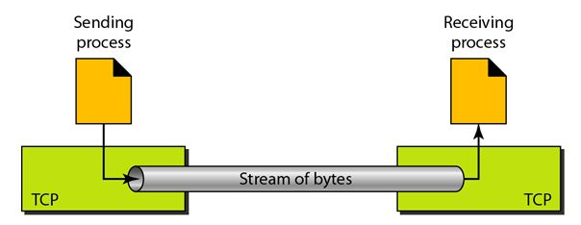
TCP Provides Stream Delivery Service

Slide 18
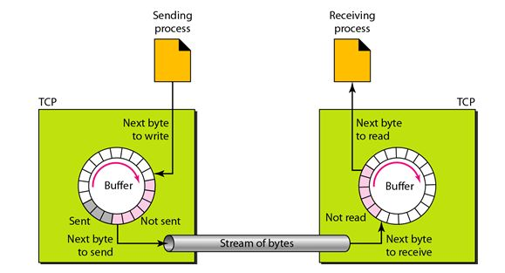
Sending and Receiving Buffers in TCP
To maintain parity between the sending and the receiving processes, TCP needs buffers for storage.

Slide 19
Segments in TCP
Although buffering handles the disparity between the speed of the producing and consuming processes, we need one more step before we can send data.
The IP layer, as a service provider for TCP, needs to send data in packets, not as a stream of bytes.
At the transport layer, TCP groups a number of bytes together into a packet called a segment.
TCP adds a header to each segment (for control purposes) and delivers the segment to the IP layer for transmission.
The segments are encapsulated in IP datagrams and transmitted.
This entire operation is transparent to the receiving process.
Segments may be received out of order, lost, or corrupted and resent.
All these are handled by TCP with the receiving process unaware of any activities.

Slide 20
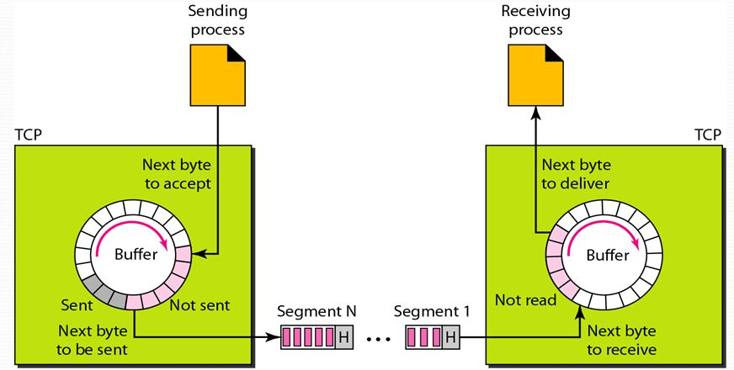
Segments in TCP
TCP offers full-duplex service
Each TCP then has a sending and receiving buffer, and segments move in both directions

Slide 21
Connection-Oriented Service in TCP
When a process at site A wants to send and receive data from another process at site B:
The two TCPs establish a connection between them.
Data are exchanged in both directions.
The connection is terminated.
This is a virtual connection, not a physical connection.
The TCP segment is encapsulated in an IP datagram and can be sent out of order, or lost, or corrupted, and then resent.
Each segment may use a different path to reach the destination.
There is no physical connection.
TCP creates a stream-oriented environment in which it accepts the responsibility of delivering the bytes in order to the other site.

Slide 22
TCP Reliable Service
TCP is a reliable transport protocol.
It uses an acknowledgment mechanism to check the safe and sound arrival of data.
Segment and ACK Numbering System
TCP keeps track of the segments being transmitted or received, but there is no field for a segment number value in the segment header.
Instead, there are two fields called the sequence number and the acknowledgment number.
These two fields refer to the byte number and not the segment number.

Slide 23
Byte Number
TCP numbers all bytes transmitted in a connection independently in each direction.
When TCP receives bytes of data from a process, it stores them in the sending buffer and numbers them.
The numbering may not start from 0.
TCP generates a random number between 0 and 2³² - 1 for the number of the first byte.
For example, if the random number happens to be 1057 and the total data to be sent are 6000 bytes, the bytes are numbered from 1057 to 7056.

Slide 24
Sequence Number
After the bytes have been numbered, TCP assigns a sequence number to each segment that is being sent.
The sequence number for each segment is the number of the first byte carried in that segment.
Example:
Suppose a TCP connection is transferring a file of 5000 bytes.
The first byte is numbered 10,001.
What are the sequence numbers for each segment if data are sent in 5 segments, each carrying 1000 bytes?
Solution:
Segment 1: Sequence Number: 10,001 (range: 10,001 to 11,000)
Segment 2: Sequence Number: 11,001 (range: 11,001 to 12,000)
Segment 3: Sequence Number: 12,001 (range: 12,001 to 13,000)
Segment 4: Sequence Number: 13,001 (range: 13,001 to 14,000)
Segment 5: Sequence Number: 14,001 (range: 14,001 to 15,000)

Slide 25
Sequence nos.
When a segment carries a combination of data and control information (piggybacking), it uses a sequence number.
If a segment does not carry user data, it does not logically define a sequence number.
The field is there, but the value is not valid.
However, some segments, when carrying only control information, need a sequence number to allow an ACK from the receiver.
These segments are used for connection establishment, termination, or abortion.
Each of these segments consumes one sequence number as though it carried 1 byte, but there are no actual data.
If the randomly generated sequence number is x, the first data byte is numbered x + 1.
The byte x is considered a phony byte that is used for a control segment to open a connection.

Slide 26
Acknowledgment Number
TCP supports full duplex communication
Each party numbers the bytes usually with a different starting byte no
The sequence number in each direction shows the number of the first byte carried by the segment.
Each party also uses separate ACK no. which specifies the number of the next byte the receiver is expecting.
ACK is cumulative.
ACK no. 5643 means, all bytes from beginning to 5642 has been received not 0 to 5642.

Slide 27
Flow Control in TCP (will be discussed later in detail)
TCP, unlike UDP, provides flow control.
The receiver of the data controls the amount of data that are to be sent by the sender.
This is done to prevent the receiver from being overwhelmed with data.
The numbering system allows TCP to use a byte-oriented flow control.

Slide 28
Error Control in TCP
To provide reliable service, TCP implements an error control mechanism.
Although error control considers a segment as the unit of data for error detection (loss or corrupted segments), error control is byte-oriented.

Slide 29
Congestion Control in TCP (will be discussed later in detail)
TCP, unlike UDP, takes into account congestion in the network.
The amount of data sent by a sender is not only controlled by the receiver (flow control), but is also determined by the level of congestion in the network.

Slide 30
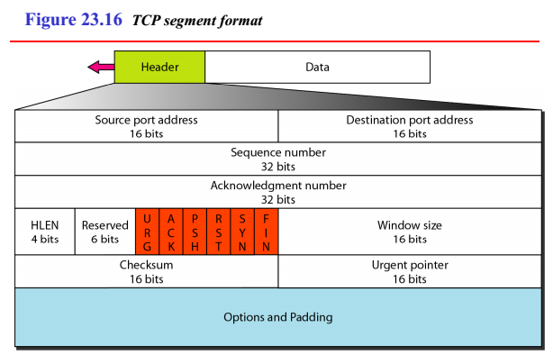
TCP segment format
20 (no options) to 60 (options) bytes header

Slide 31
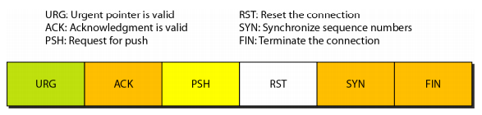
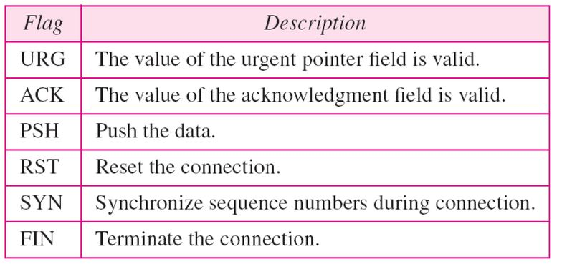
Description of flags in the control field
URG:
16-bit field
valid only if the urgent flag is set,
Used when the segment contains urgent data.
Defines the number that must be added to the sequence number to obtain the number of the last urgent byte in the data section of the segment.

Slide 32
TCP segment format
Valid only if URG is set. Used when segment carries urgent data. It defines the no. to be added to the seq. no. to obtain the no. of the last urgent byte in the data section of the segment.
No. of 4byte words in the TCP header
Receiver Window Size

Slide 33
TCP Connection
TCP is connection-oriented.
A connection-oriented transport protocol establishes a virtual path between the source and destination.
All the segments belonging to a message are then sent over this virtual path.
Using a single virtual pathway for the entire message facilitates the acknowledgment process as well as retransmission of damaged or lost frames.

Slide 34
TCP Connection
How can TCP, which uses the services of IP, (a connectionless protocol), be connection-oriented?
TCP connection is virtual, not physical.
TCP operates at a higher level.
TCP uses the services of IP to deliver individual segments to the receiver, but it controls the connection itself.
If a segment is lost or corrupted, it is retransmitted.
Unlike TCP, IP is unaware of this retransmission.
If a segment arrives out of order, TCP holds it until the missing segments arrive; IP is unaware of this reordering.

Slide 35
TCP Connection

Slide 36
TCP Connection
In TCP, connection-oriented transmission requires three phases:
connection establishment,
data transfer, and
connection termination.

Slide 37
Three-Way Handshaking
An application program, (client), wants to make a connection with another application program, (server), using TCP.
The handshaking process starts with the server.
The server program tells its TCP that it is ready to accept a connection.
This is called a request for a passive open.
Although the server TCP is ready to accept any connection from any machine in the world, it cannot make the connection itself.
The client program issues a request for an active open.
A client that wishes to connect to an open server tells its TCP that it needs to be connected to that particular server.
TCP can now start the three-way handshaking process.

Slide 38
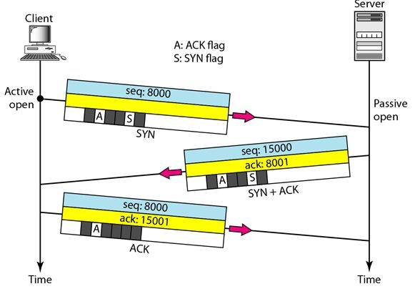
Three-Way Handshaking: Connection Establishment
The client sends the 3rd segment.
This is just an ACK segment. It acknowledges the receipt of the 2nd segment with the ACK flag and ACK no. field.
The sequence number in this segment is the same as the one in the SYN segment;
ACK segment does not consume any seq. nos.
The server sends the 2nd segment, SYN + ACK segment, with 2 flag bits SYN and ACK set.
This segment has a dual purpose.
It is a SYN segment for communication in the other direction and serves as the acknowledgment for the SYN segment.
It consumes one sequence number.
1st segment, a SYN segment, only the SYN flag is set.
This segment is for synch. of seq. nos.
It consumes 1 seq. no.
When the data transfer starts, the seq. no. is incremented by 1.
SYN segment carries no real data, but contains 1 imaginary byte.

Slide 39
Three-Way Handshaking
Simultaneous Open (RARE)
Both processes issue an active open.
Both TCPs transmit a SYN + ACK segment to each other, and one single connection is established between them.

Slide 40
SYN Flooding Attack
The connection establishment procedure in TCP is susceptible to this attack.
A malicious attacker sends a large number of SYN segments to a server,
It pretending that each of them are coming from a different client by faking the source IP addresses in the datagrams.
The server, assuming that the clients are issuing an active open, allocates the necessary resources.
The TCP server then sends the SYN +ACK segments to the fake clients, which are lost.

Slide 41
SYN Flooding Attack
During this time, however, a lot of resources are occupied without being used.
If the number of such SYN segments is large, the server eventually runs out of resources and may crash.
This attack belongs to a type of security attack known as a denial-of-service attack,
An attacker monopolizes a system with so many service requests that the system collapses and denies service to every request.

Slide 42
Possible Solutions to SYN Flooding Attack
Some have imposed a limit on connection requests during a specified period of time.
Others filter out datagrams coming from unwanted source addresses.
One recent strategy is to postpone resource allocation until the entire connection is set up, using a cookie.
SCTP, uses this strategy.

Slide 43
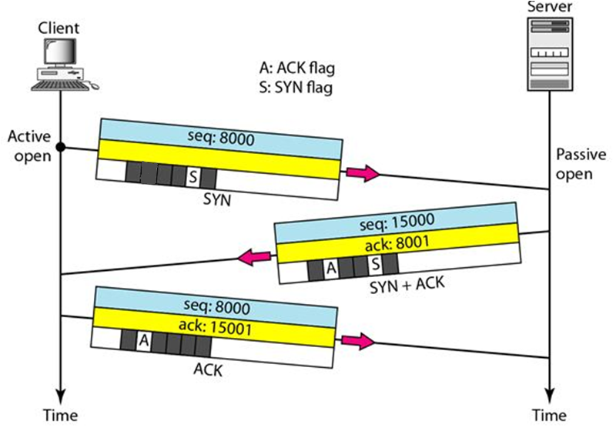
Three-Way Handshaking: Connection Establishment

Slide 44
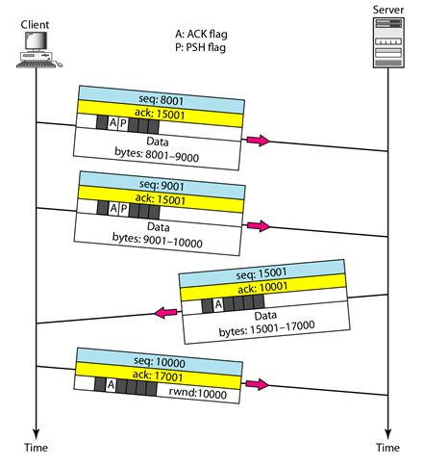
Data Transfer
PUSH flag set indicates push data to server process as soon as received. TCP should not wait for the rwindow to be filled up. Used for interactive applications
The URG flag is also somewhat similar but is used for scenarios where Cntrl+C has to be pressed

Slide 45
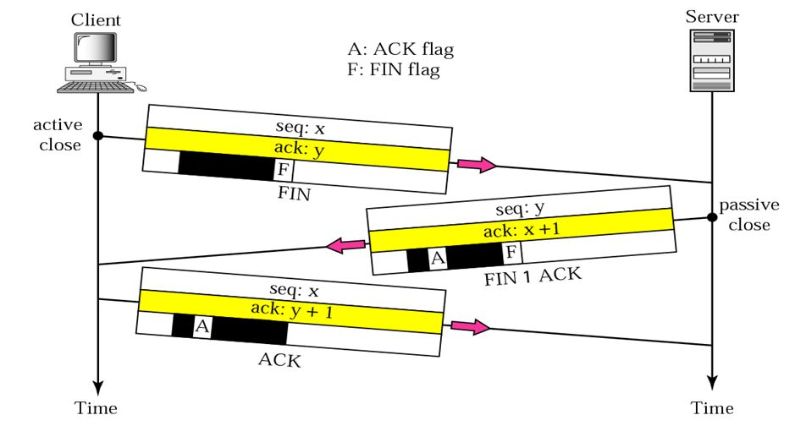
Three way handshaking: Connection Termination
The client TCP normally, after receiving a close command from the client process, sends the 1st segment, with the FIN flag is set. A FIN segment can include the last chunk of data sent by the client, or it can be just a control segment as in this case. If it is only a control segment, it consumes only one sequence number
The client TCP sends the last segment, an ACK segment, to confirm the receipt of the FIN segment from the TCP server. This segment contains the ACK number, which is 1 plus the seq. no. received in the FIN segment from the server. This segment cannot carry data and consumes no sequence numbers.
The server TCP, after receiving the FIN segment, informs its process and sends the second segment, FIN + ACK segment, to confirm the receipt from the client and at the same time to announce the closing of the connection in the other direction.
This segment can also contain the last chunk of data from the server. If it does not carry data, it consumes only one sequence number.

Slide 46
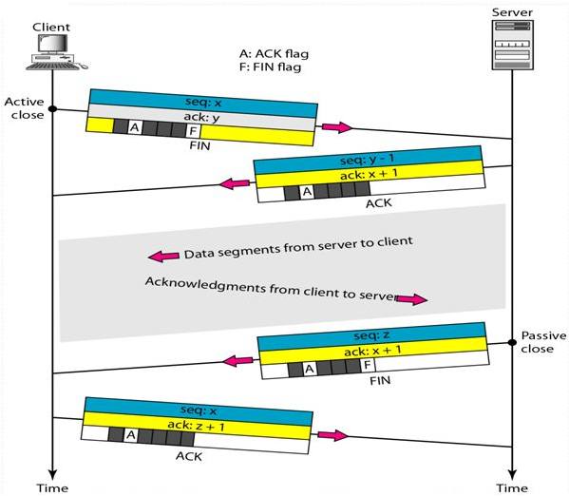
Half-Close
One end can stop sending data but can continue to receive.
Occurs when server needs all data before processing. E.g. sorting
After half-close, data can travel from the server to the client and ACKS can travel from the client to the server but not vice-versa

Slide 47
TCP Features
Flow Control
TCP uses sliding window for flow control
Somewhere in between Go-Back-N and Selective Repeat.
Go-Back-N: because it does not use NAKs
Selective Repeat: because the receiver holds the out-of-order segments until the missing ones arrive
Differences with sliding window of Data Link Layer:
the sliding window of TCP is byte-oriented while in the data link layer it is frame-oriented
TCP's sliding window is of variable size; while the one used in the data link layer was of fixed size.
Error Control
Congestion Control

Slide 48
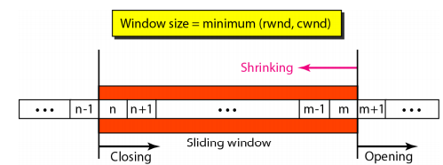
Sliding Window
Rwnd: receiver window. It is the value advertised by the opposite end in a segment containing ACK. It is the no. of bytes the receiver can accept before its buffer overflows
Cwnd: Contention window. It is a value determined by the network to avoid congestion
Strongly discouraged. revoking the eligibility of some bytes from being send
Cannot move left
ACK awaited
ACK received need not worry
Allows more bytes to be sent

Slide 49
Sliding Window
The source does not have to send a full window’s worth of data.
The window can be opened or closed by the receiver, but should not be shrunk.
The destination can send an acknowledgment at any time as long as it does not result in a shrinking window.
The receiver can temporarily shut down the window; the sender, however, can always send a segment of 1 byte after the window is shut down

Slide 50
TCP Features
Flow Control
Error Control (detecting corrupted segments, lost segments, out-of-order segments, and duplicated segments and for correcting errors after they are detected)
Checksum:
check for a corrupted segment.
If found, it is discarded by the destination TCP and is considered as lost
ACK
All segments with seq. no. are acknowledged.
ACK segments have no seq. no. hence not acknowledged
Retransmission
Congestion Control

Slide 51
Retransmission
Heart of the error control mechanism
When a segment is corrupted, lost, or delayed, it is retransmitted.
Retransmission occurs
When retransmission timer expires
When sender receives 3 duplicate ACKs
No retransmission for segments w/o seq. nos., i.e. ACK segment

Slide 52
When retransmission timer expires
The earliest outstanding segment is retransmitted
Irrespective of lack of a received ACK
Segment with only ACKs are never resent.
Value of Retransmission Time-out (RTO) is dynamic
Updated based on the round-trip time (RTT) of segments.
Retransmission Time Interval (RTI)
time needed for a segment to reach a destination and for an ACK to be received.
It uses a back-off strategy similar to one discussed earlier in data link layer
This strategy works if the value of RTO is not very large.

Slide 53
When sender receives 3 duplicate ACKs
If, one segment is lost, receiver may receive many out-of-order segments that they cannot be saved (limited buffer size).
Solution: 3-duplicate-ACKs rule and retransmit the missing segment immediately.
This feature is referred to as fast retransmission

Slide 54
Handling out of order segments
Most implementations today do not discard the out-of-order segments.
They store them temporarily and flag them as out-of-order segments until the missing segment arrives.
Out-of-order segments are not delivered to the process.
TCP guarantees that data are delivered to the process in order.

Slide 55
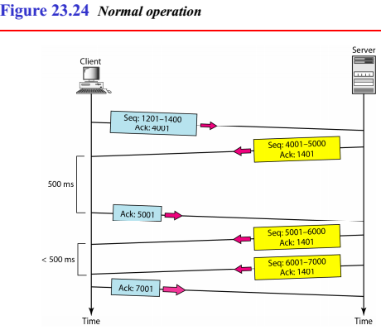
Some Scenarios: Delayed ACK
bidirectional data transfer between two systems
Delayed ACK
ACK should be sent every 0.5 s
in a stream of full-sized segments there SHOULD be an ACK for at least every second segment.
Improves B/W efficiency

Slide 56
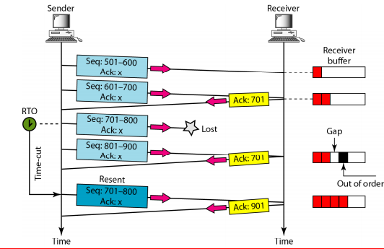
Some Scenarios: Lost Segment

Slide 57
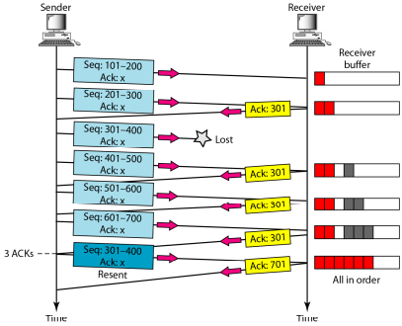
Some Scenarios: Fast Retransmission
RTO is high
So opting for 3 duplicate ACKs

Slide 58
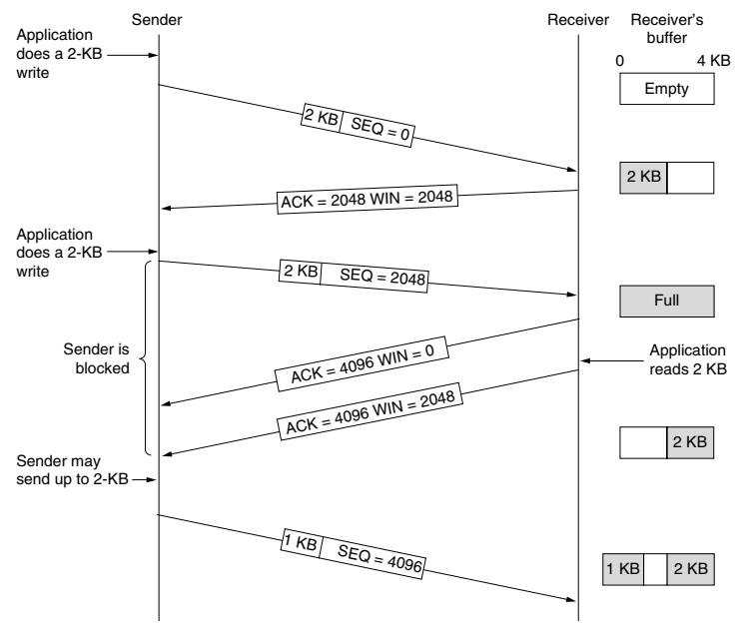
Receiver controls the flow
When the window is 0, the sender may not normally send segments, with two exceptions.
1st, urgent data may be sent, e.g., to allow the user to kill the process running on the remote machine.
2nd, the sender may send a 1-byte segment to force the receiver to re-announce the next byte expected and the window size.
This packet is called a window probe.

Slide 59
Nagle’s Algorithm
Delayed ACK improves efficiency but
A sender that sends multiple short packets (e.g., 41 packets containing 1 byte of data) is still operating inefficiently.
Solution: Nagle’s algorithm
When data come into the sender TCP in small pieces, just send the 1st piece and buffer all the rest until the 1st piece is acknowledged.
Then send all the buffered data in 1 TCP segment and start buffering again until the segment is acknowledged.
That is, only one short packet can be outstanding at any time.
If many pieces of data are sent by the application in one RTT, Nagle’s algorithm will put the many pieces in one segment, greatly reducing the bandwidth used.
The algorithm additionally says that a new segment should be sent if enough data have trickled in to fill a maximum segment.

Slide 60
Problems with Nagle’s Algorithm
In interactive games that are run over the Internet, the players typically want a rapid stream of short update packets.
Gathering the updates to send them in bursts makes the game respond erratically, which makes for unhappy users.
A more subtle problem is that Nagle’s algorithm can sometimes interact with delayed acknowledgements to cause a temporary deadlock:
the receiver waits for data on which to piggyback an ACK,and
the sender waits on the acknowledgement to send more data.
This interaction can delay the downloads of Web pages.
Because of these problems, Nagle’s algorithm can be disabled (which is called the TCP NODELAY option).

Slide 61
Silly Window Syndrome
Say data are passed from the appl. Layer to the sending TCP entity in large blocks, but the application on the receiving side reads data only 1 byte at a time.
Initially, the TCP buffer on the receiving side is full (i.e., it has a window of size 0) and the sender knows this.
Then the application reads 1 byte from the TCP stream/buffer.
So the receiving TCP sends a window update to the sender saying that it is all right to send 1 byte.
The sender obliges and sends 1 byte.
The buffer is now full, so the receiver acknowledges the 1-byte segment and again sets the window to 0.
This behaviour can go on forever.

Slide 62
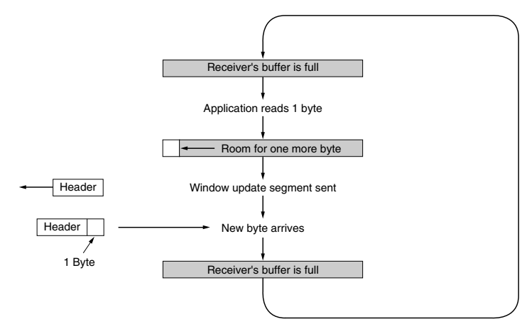
Silly Window Syndrome

Slide 63
Clark’s Solution to the Silly Window Syndrome
Clark’s solution proposed to prevent the receiver from sending a window update for 1 byte.
Instead, it is forced to wait until it has a decent amount of space available and advertise that instead.
Specifically, the receiver should not send a window update until it can handle the maximum segment size it advertised during connection establishment or until its buffer is half empty, whichever is smaller.
Furthermore, the sender can also help by not sending tiny segments.
Instead, it should wait until it can send a full segment, or at least one containing half of the receiver’s buffer size

Slide 64
Can Nagle’s Algorithm solve the Silly Window Syndrome
Well yes it can.
Nagle’s algorithm and Clark’s solution to the silly window syndrome are complementary.
Nagle solved the problem caused by the sending application delivering data to TCP a byte at a time.
Clark solved the problem of the receiving application sucking the data up from TCP a byte at a time.
Both solutions are valid and can work together.
The goal is for the sender not to send small segments and the receiver not to ask for them.

Slide 65
TCP Timer Management : RTO
When a segment is sent, a retransmission timer is started.
If the segment is acknowledged before the timer expires, the timer is stopped.
If, on the other hand, the timer goes off before the acknowledgement comes in, the segment is retransmitted (and the timer is started again).
The question that arises is: how long should the timeout be?
If the timeout is set too short, say, T₁ , unnecessary retransmissions will occur, clogging the Internet with useless packets.
If it is set too long (T₂), performance will suffer due to the long retransmission delay whenever a packet is lost.
Furthermore, the mean and variance of the ACK arrival distribution can change rapidly within a few seconds as congestion builds up or is resolved.

Slide 66
TCP Timer Management: RTO
Solution: Dynamic algorithm that constantly adapts the timeout interval, based on continuous measurements of network perf.
For each connection, TCP maintains a variable, SRTT (Smoothed Round-Trip Time), i.e., the best current estimate of the RTT to the destination in question.
When a segment is sent, a timer is started, both to see how long the ACK takes and also to trigger a retransmission if it takes too long.
If the ACK gets back before the timer expires, TCP measures how long the ACK took, say, R.
It updates SRTT according to the formula SRTT = α SRTT + (1 - α) R where α is a smoothing factor that determines how quickly the old values are forgotten. Typically, α = 7/8.

Slide 67
TCP Timer Management: Persistence Timer
Designed to prevent the following deadlock.
The receiver sends an ACK with a window size of 0, telling the sender to wait.
Later, say the receiver updates the window, but the packet with the update is lost.
Now the sender and the receiver are each waiting for the other to do something.
When the persistence timer goes off, the sender transmits a probe to the receiver.
The response to the probe gives the window size.
If it is still 0, the persistence timer is set again and the cycle repeats.
If it is nonzero, data can now be sent.

Slide 68
TCP Timer Management: Keepalive timer
A keepalive timer is used to prevent a long idle connection between two TCPs.
If a client opens a TCP connection to a server transfers some data and becomes silent the client will crash.
In this case, the connection remains open forever.
So a keepalive timer is used and each time the server hears from a client, it resets this timer.
The time-out is usually 2 hours.
If the server does not hear from the client after 2 hours, it sends a probe segment.
If there is no response after 10 probes, each of which is 75 s apart, it assumes that the client is down and terminates the connection.

Slide 69
TCP Timer Management: Time Wait Timer
This timer is used during tcp connection termination.
The timer starts after sending the last Ack for 2nd FIN and closing the connection.
After a TCP connection is closed, it is possible for some delayed segments to attempt to access the closed port.
The quiet timer is intended to prevent the just-closed port from reopening again quickly and receiving these last segments.
The quiet timer is usually set to twice the maximum segment lifetime (the same value as the Time-To-Live field in an IP header), ensuring that all segments still heading for the port have been discarded.

Slide 71
TCP Congestion Control

Slide 72
Recap
Actual window size = minimum (rwnd, cwnd)
rwnd is obtained from the receiver and cwnd is based on the congestion in the network.
TCP's policy for handling congestion is based on three phases:
slow start,
congestion avoidance, and
congestion detection.

Slide 73
Congestion Control: Slow Start
Exponential increase:
the size of the congestion window (cwnd) starts with one maximum segment size (MSS).
The MSS is determined during connection establishment.
The size of the window (cwnd) increases one MSS each time an ACK is received.
The window starts growing slowly, but grows exponentially until it reaches a threshold (ssthreshold = 65,535 bytes).

Slide 74
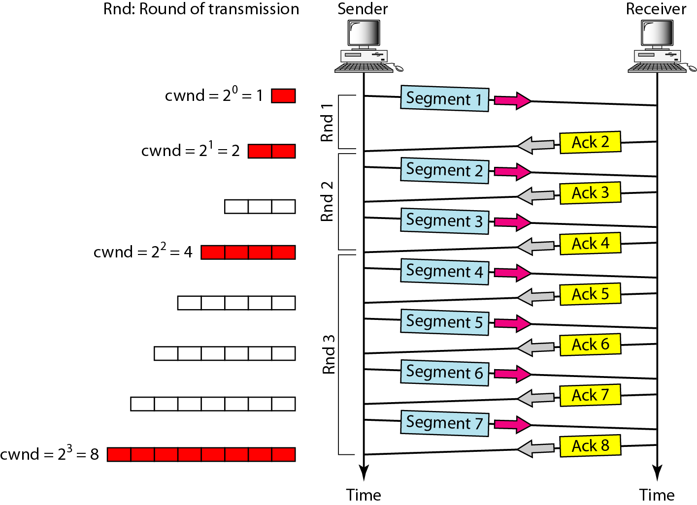

Slide 75
Congestion Control: Congestion avoidance
With the slow-start algorithm, the size of the congestion window increases exponentially.
To avoid congestion before it happens, one must slow down this exponential growth.
When the cwnd reaches the slow-start threshold, the slow-start phase stops and the additive phase begins.
Additive increase
In this phase, the size of the congestion window increases additively until congestion is detected.

Slide 76
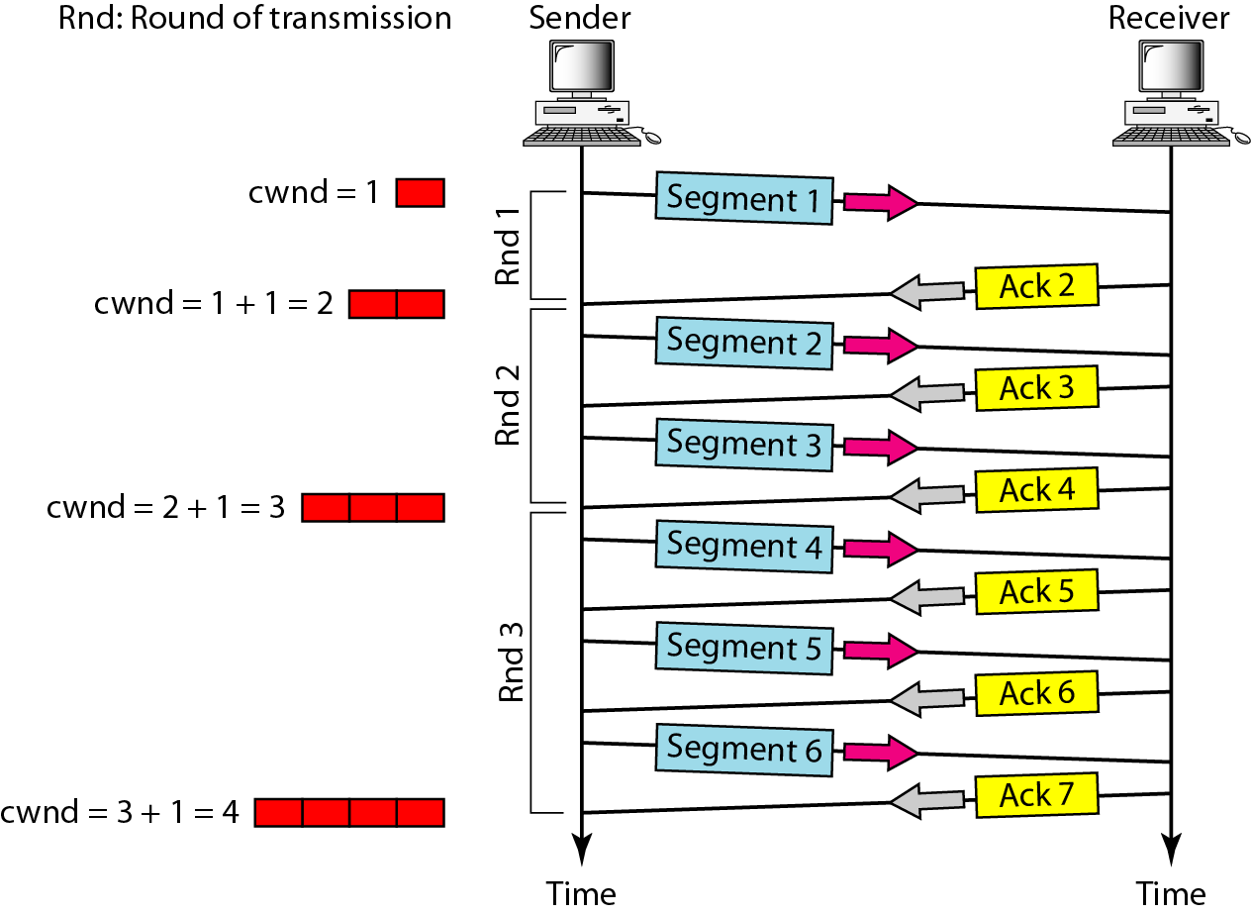

Slide 77
Congestion Control: Congestion Detection
If congestion occurs, the cwnd size must be decreased.
Sender can guess that congestion has occurred only if it needs to retransmit a segment.
Retransmission can occur in one of two cases:
when a timer times out (stronger possibility of congestion)
when three ACKs are received.(weaker possibility of congestion)

Slide 78
Congestion Control: Congestion Detection
When a timer times out (stronger possibility of congestion)
a new slow start phase starts.
It sets the value of the threshold to one-half of the current window size.
It sets cwnd to the size of one segment.
It starts the slow-start phase again.

Slide 79
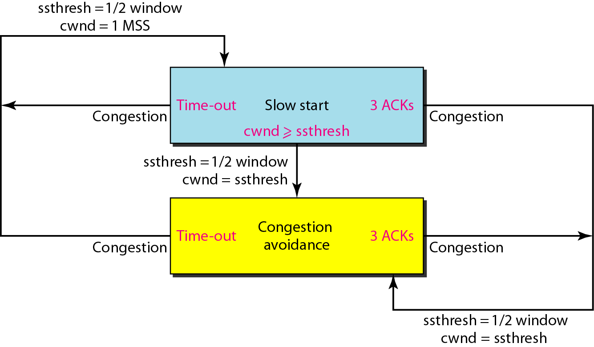

Slide 80
Congestion Control: Congestion Detection
When 3ACKs are received (weaker possibility of congestion),
a new congestion avoidance phase starts.
This is called fast transmission and fast recovery
It sets the value of the threshold to one-half of the current window size.
It sets cwnd to the value of the threshold (some implementations add three segment sizes to the threshold).
It starts the congestion avoidance phase.

Slide 82
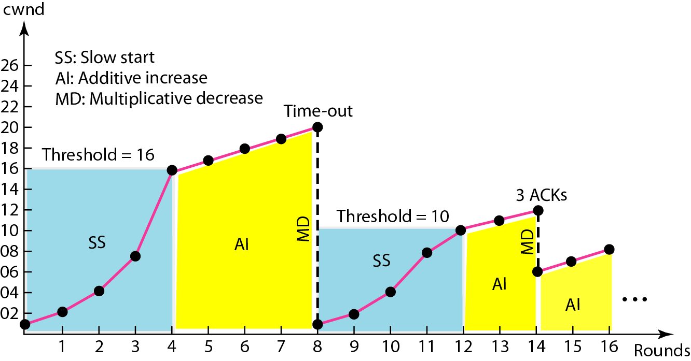
Figure 24.11 Congestion example
Max window size=32 segments
Ssthresh = 16 segments
Window size is 20
½ window size
Slow start
Congestion avoidance
Slow start
Congestion avoidance

